Slide 1
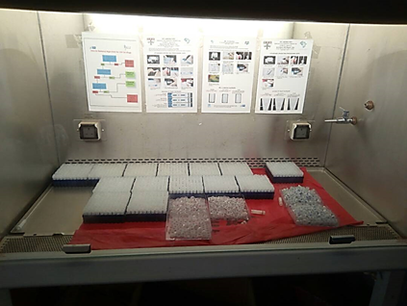
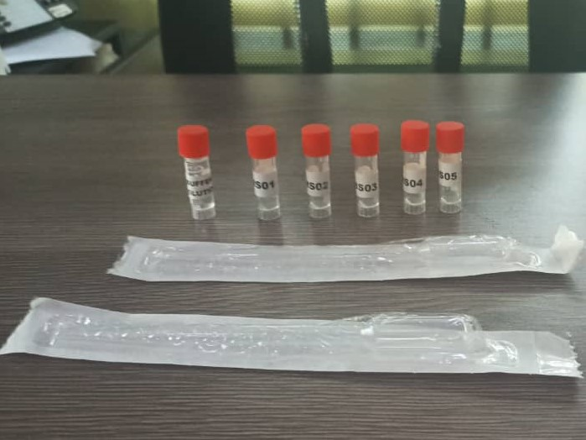
DTS-Based Proficiency Testing (PT) Program
Overview of the Nigerian Experience: Scaling-up with Sustainability
At The RTCQI African Regional Best Practice Workshop, Cape Town South Africa
Date: June 3-7, 2024

Slide 2
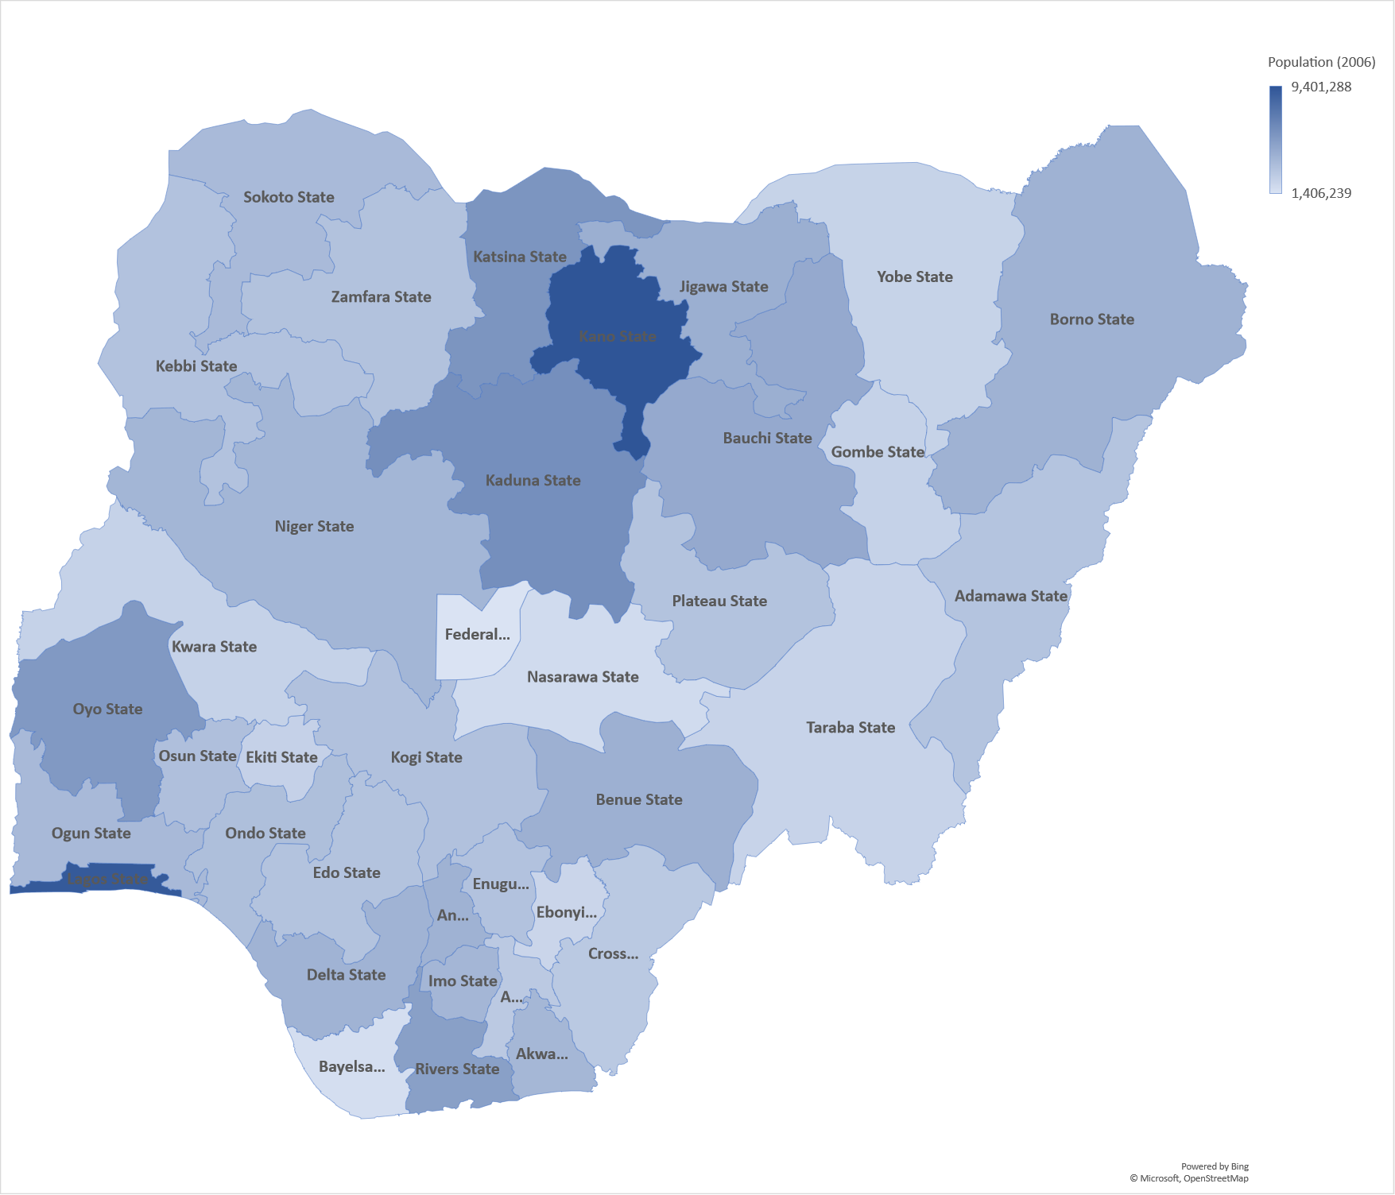
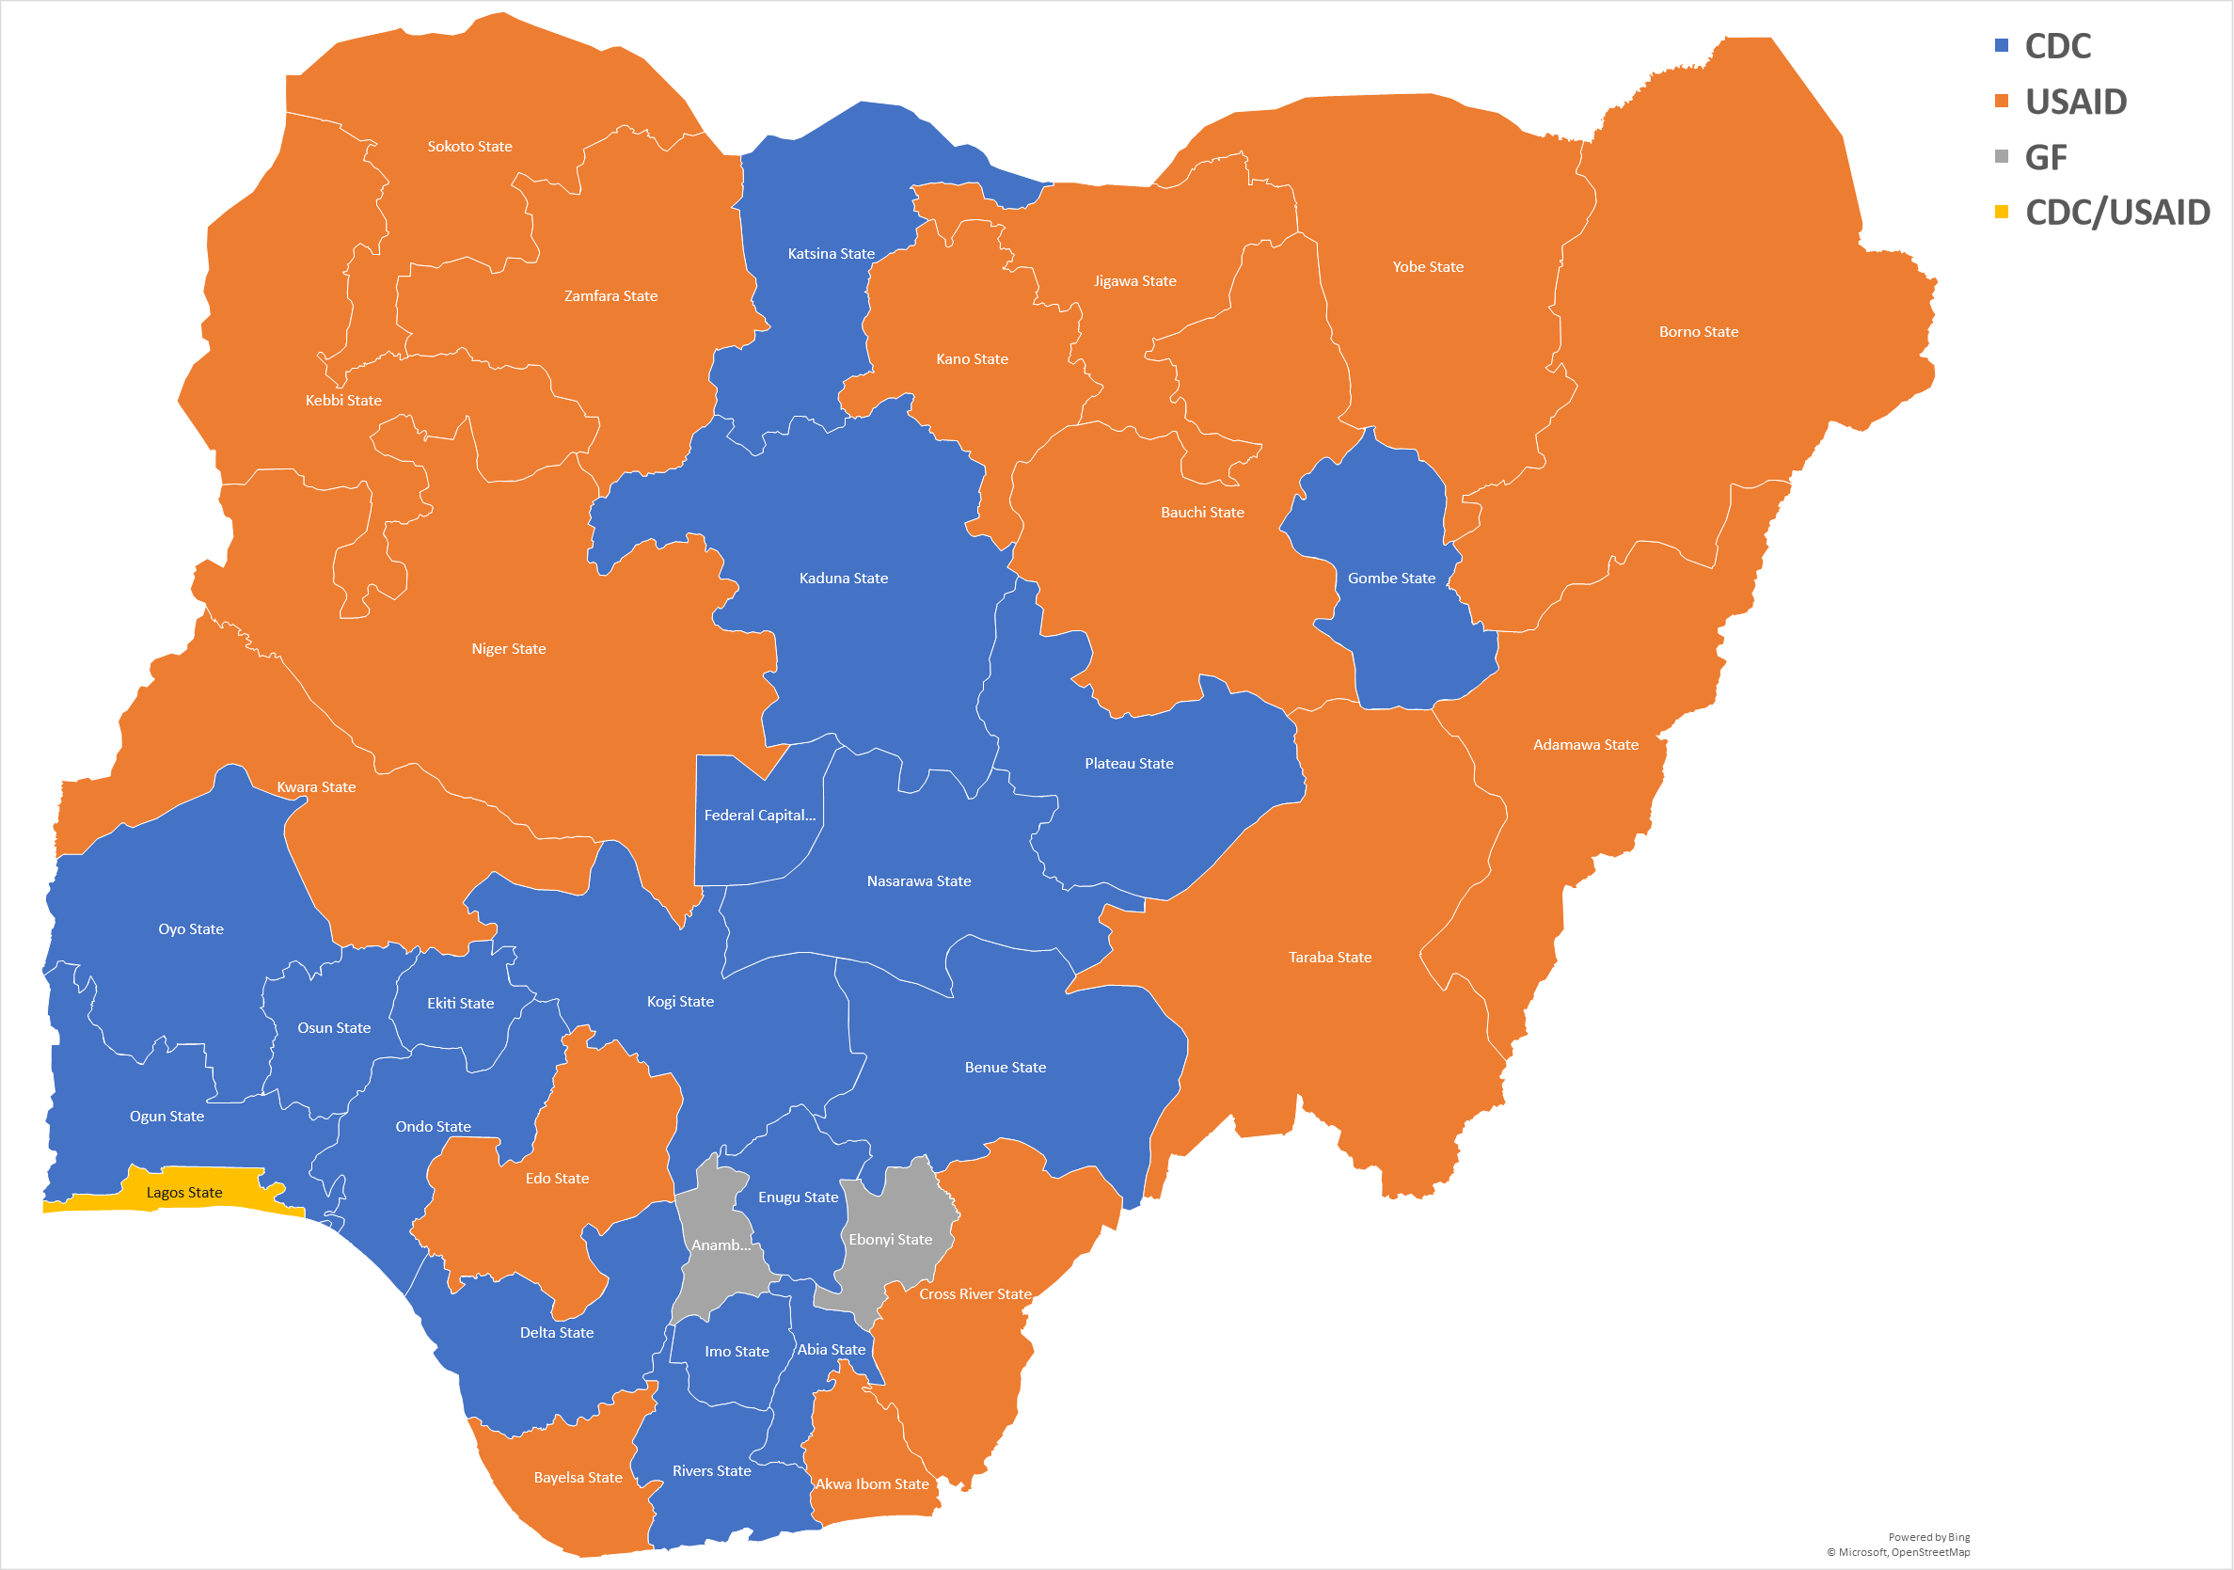
Nigeria: Population and CDC State Coverage
Year | 2006 (National Bureau of Statistics) | 2019 (National Bureau of Statistics) | 2022 Estimate (World Bank)
Population | 140,431,790 | 201,135,262 | 218,541,212
US Centers for Disease Control and Prevention (CDC) Supports 18 + 1 States in Nigeria.
Representing 51% sub-national units(SNUs).
  All shades of blue and yellow (in lower map).
Sources:
National Bureau of Statistics(2024). Nigeria Total Population. Available: https://nigeria.opendataforafrica.org/bapijf/total-population. Accessed: May 3, 2024
World Bank(2024): Population, total – Nigeria. Available https://data.worldbank.org/indicator/SP.POP.TOTL?end=2022&locations=NG&name_desc=true&start=2022&view=map. Accessed: May 5, 2024
Notes:
Implementation data will focus across all shades of blue coloured states. CIHP supported states are in the darker shades of blue.

Slide 3
Country Phased-Approach Implementation of RTCQI
CDC-led National trainings.
IP-led State level trainings for: IP staff, SMoH, SQIT and HIV testers.
RTCQI Implementation:
  DTS-Based integrated PT
  SPI-RT Audit (using Version 4.0)
  Quality Control (QC)
  Worksheet Analysis
  Test service point Certification
  Site visit and monitoring
Early 2015
* Adopted CDC ILB Training Materials.
Late FY 15
*Clustered National ToT
Abuja (21 participants)
Lagos (29 participants)
FY 16
*State-level trainings across four (4) states: Benue, FCT, Lagos, & Nasarawa –Testers, SQIT, SMoH, and IP Staff
FY17-FY18
Scale-up across Sustained 18+1 states
FY19 –Till Date
* Integrated RTCQI – HIV/RTRI
* September 2020
Early roll-out phase
Nationwide expansion phase
Notes:
Implementation data will focus across all shades of blue coloured states. CIHP supported states are in the darker shades of blue.

Slide 4
RTCQI Coverage – Testing Points and Competent Testers

Slide 5


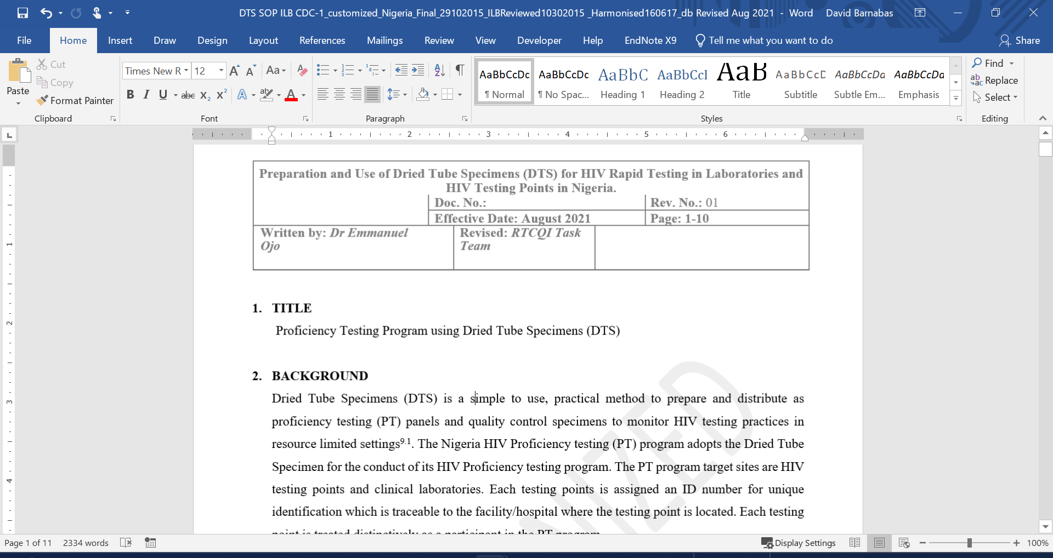
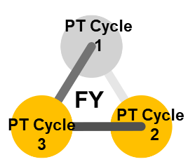




Proficiency Testing (PT) Program Background
DTS based Integrated– HIV and Recency PT program.
Phased decentralization QC & PT panel production.
Monitor panel production across states
Review PT outcome across IPs.
Integrated 3 Cycles/fiscal year - reported in Jan, May, and Sept.
Leveraged on electronic platforms
Harmonized SOPs for PT.
PT results returned within 2 weeks of panel distribution.
Report provided within 4 – 5 weeks from PT result submission.
Report determines applicable actions – retraining, testing or cessation of testing.
Annual PT Reference Results Development.

Slide 6
Stakeholders and Roles
National HIV/AIDS, Viral Hepatitis and STIs Control Programme (NASCP), Federal Ministry of Health (FMoH) – policy formulation, coordination and technical implementation
State HIV/AIDS, Viral Hepatitis and STIs Control Programme (SASCP), State Ministry of Health (SMoH) - at the state level (SNU).
State Quality Improvement Team (SQIT)
Donors and development partners

Slide 7

Panel Production
Building capacity
Ensuring sustainability
Biobank/repository
Using technology to track
National DTS-Based Panel Production - early phase
IP Centralized PT Production scale up
* IP-Led decentralized PT panel production
* IP centralized review and reporting (surge era)
Scalability
Cost Efficiency
Reach
Sustainability

Slide 8
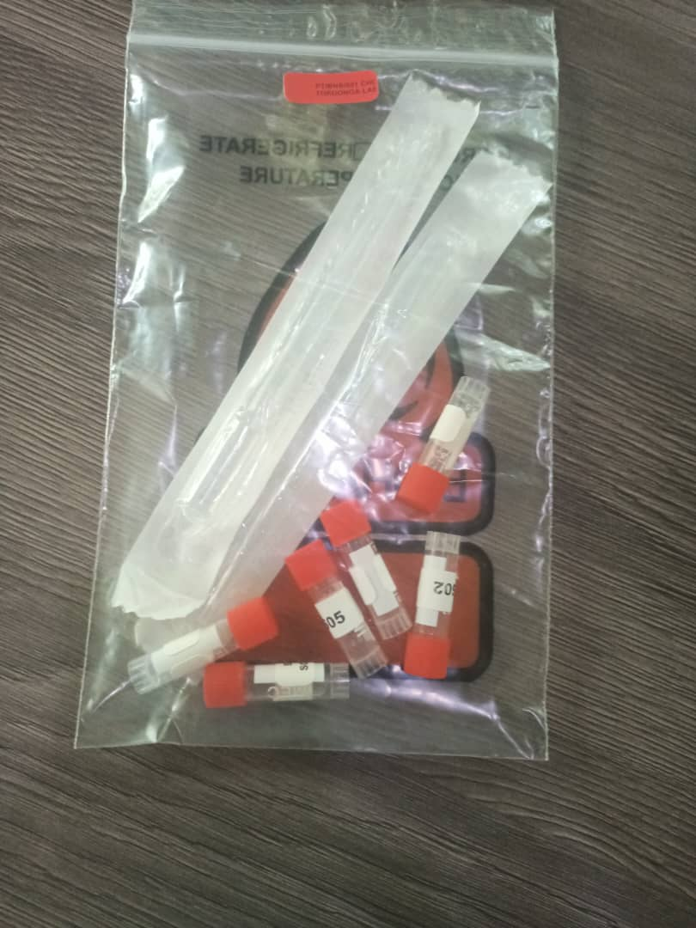
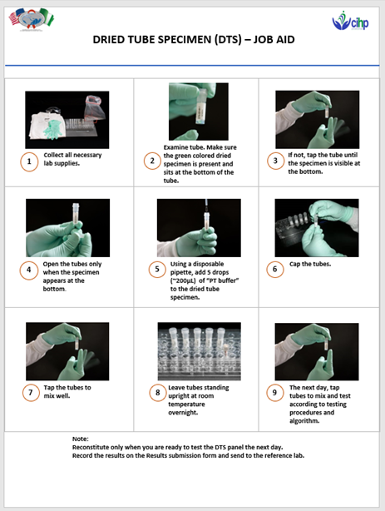
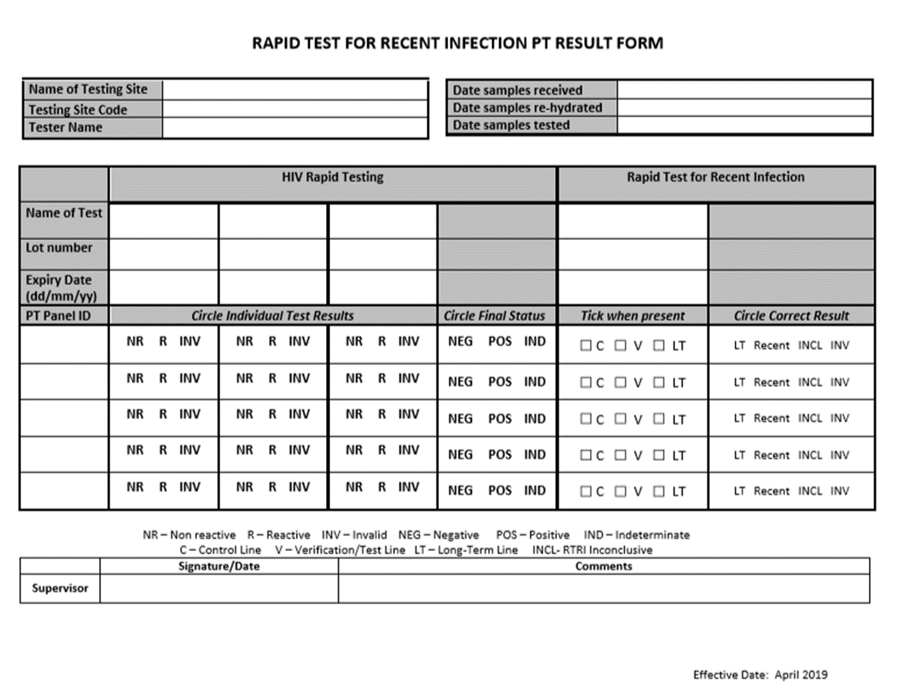
Panel Production: Packaging and Distribution
5 panel tubes
1 Buffer tube
2 transfer pipettes
Instruction sheet
DTS job aid
Results form

Slide 9
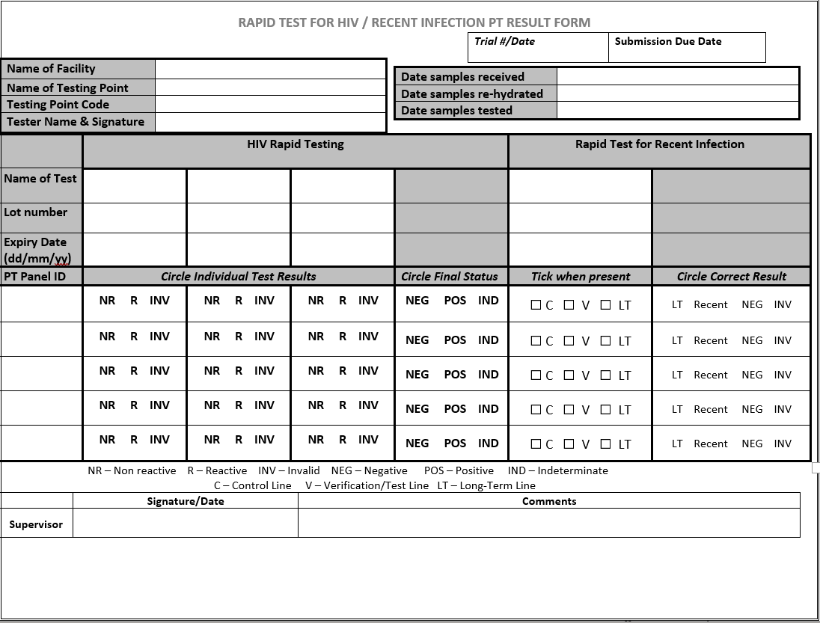
PT Scoring Criteria
Correct Documentation: 10%
  Algorithm compliance – 5%
  Kit information – 2%
  Testing point details – 1%
  Tester details – 1%
  Testing process (i.e., reconstitution testing dates) – 1%
2. Correctly identifying all samples: 90%
  The pass mark is 90% (based on correct results for all 5 samples)
3. Automatic Failures:
Non-adherence to National testing algorithm
Kit information (kit name, lot # , exp date) not provided
Use of expired test kits
Notes:
Implementation data will focus across all shades of blue coloured states. CIHP supported states are in the darker shades of blue.

Slide 10
PT Program Summary FY16-FY24 (SAPR) - Performance &Trend

Slide 11
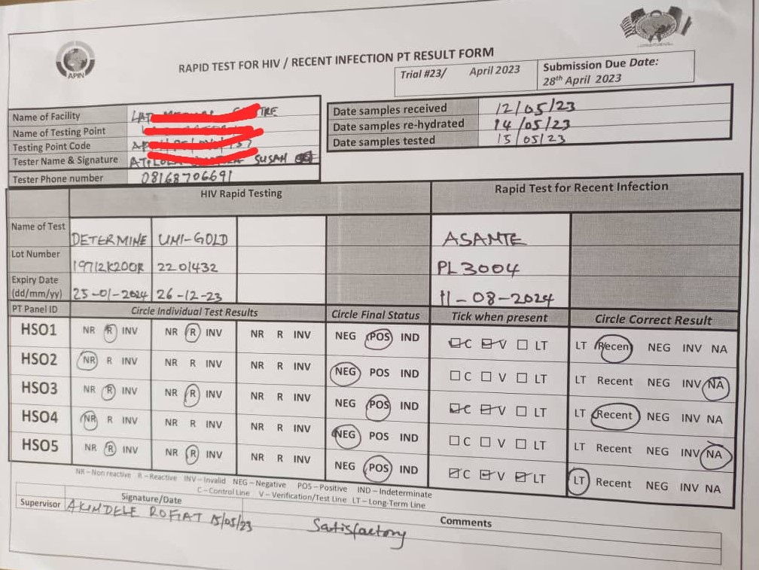
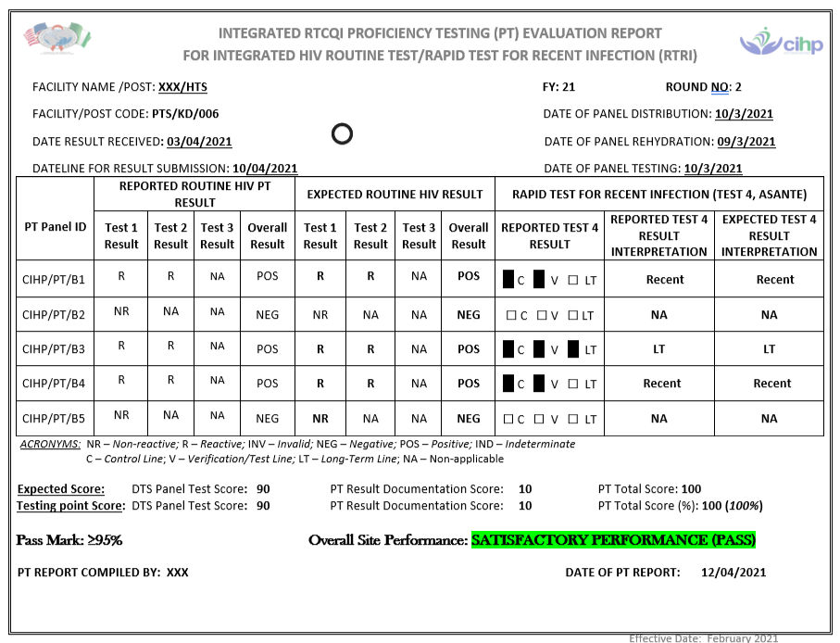
Proficiency Testing (PT) Program Scale up and Next Phase
Integrated PT program includes routine HIV rapid test and HIV-1 Rapid Test For Recent Infection (RTRI)
Government of Nigeria HCWs are involved in PT program
Joint monitoring and supportive site visit
Multi-disease (TB and CM ) DTS-based PT program (next phase).

Slide 12
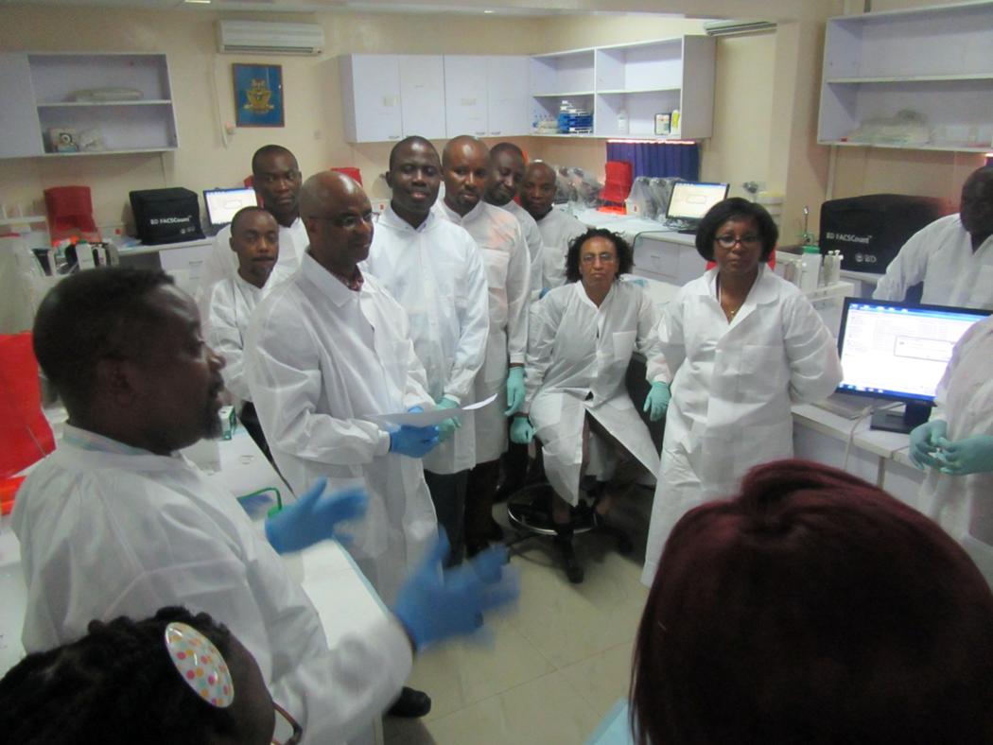
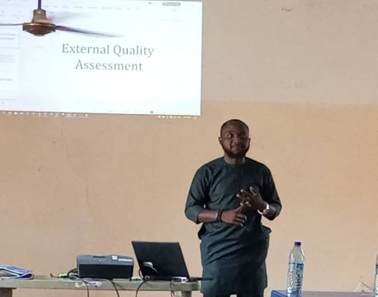
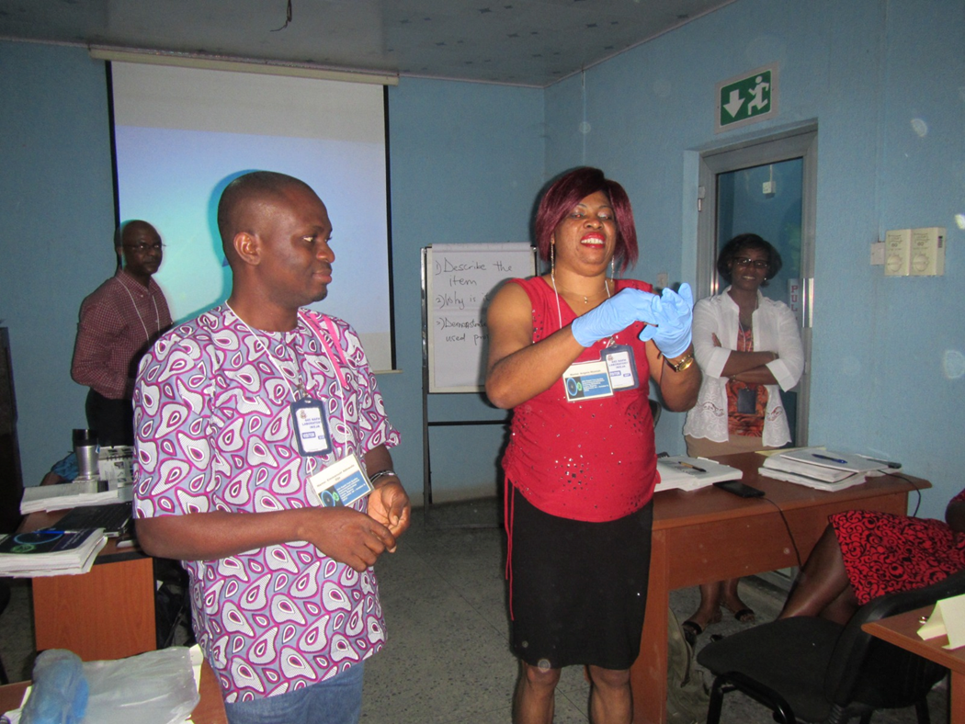

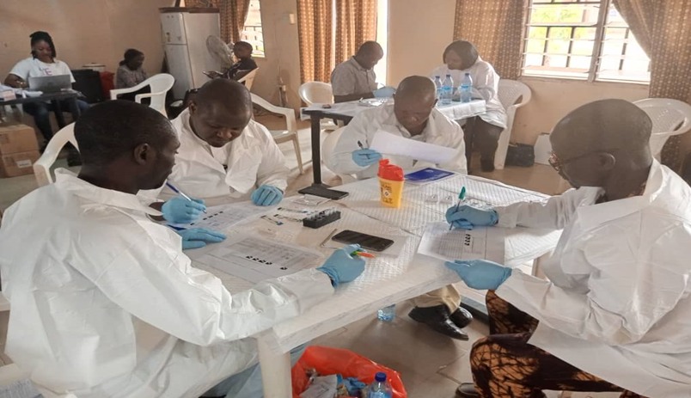

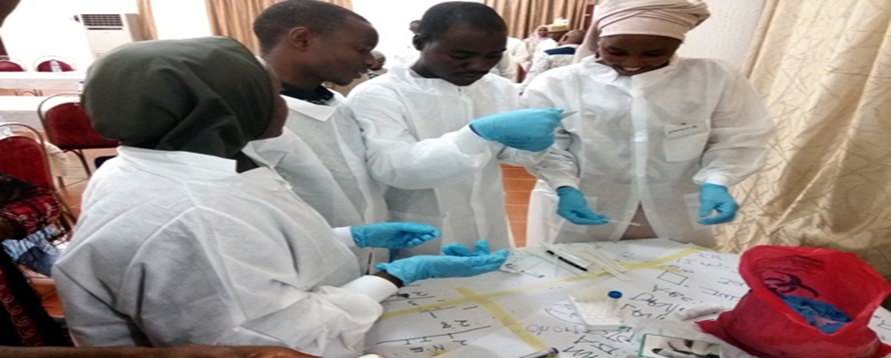
Program Success and Lessons Learned
National and State-level coordination and stratified technical support.
Government involvement.
Active engagement of SQIT in all RTCQI program
Tiered-level RTCQI trainings and refreshers
RTCQI scale up implementation amidst IP transitions, HCWs attrition and insecurity.
Over 1,800 HIV testing points participating

Slide 13
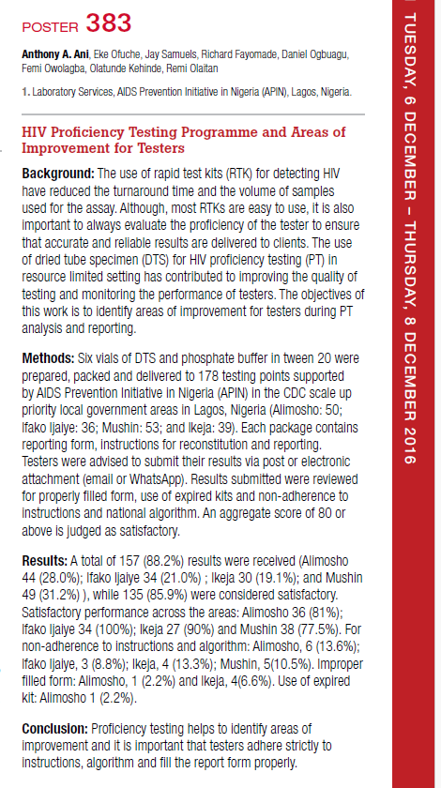
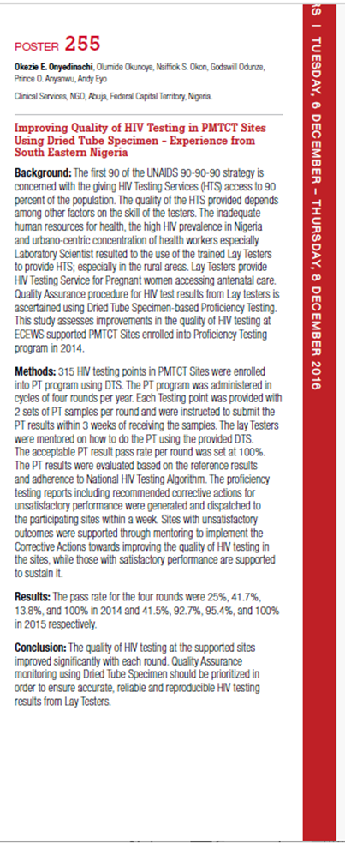
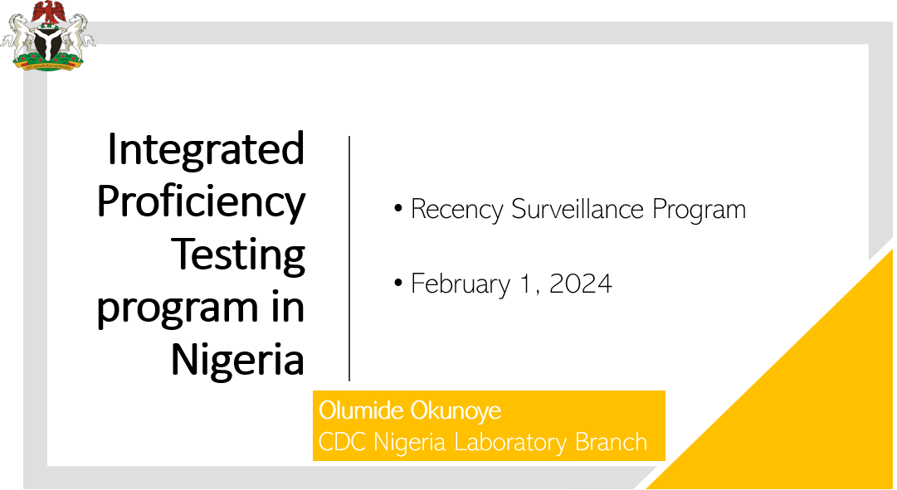
Program Success and Lessons Learned (2)
Dissemination and learnings
Year | December 2016 | December 2017 | December 2018 | February 2024
Platform | ASLM, Cape Town, South Africa | ICASA, Abidjan, Côte D Ivoire | ASLM, Abuja, Nigeria | Webinar

Slide 14
Program Challenges and Recommended Actions
S/N | Program Challenges | Actions
 | High attrition among testers | Continuous Training
2. | Security challenges especially in some parts of the country limits ‘physical’ supportive site supervision | Use of indigenous SQIT for RTCQO activities Virtual and use of technological tools for remote support.

Slide 15
Acknowledgement
National/State HIV/AIDS, Viral Hepatitis and STIs Control Programme (NASCP/SASCP), Federal/State Ministry of Health (FMoH/SMoH), Nigeria.
CDC
APIN-PHI
CCFN
CIHP
ECEWS
IHVN
PHIS 3

Slide 16
HIV DTS-based PT program allows cost-effective rapid testing quality monitoring particularly among lay counsellor testers .
…RTCQI Assures Quality
Thank you

